Slide 1
INCASE catchment approach
Why (Jane)? Bring related datasets together in a standardised way to inform better decisions about use of natural capital
What is NCA (Carl)? Using accounting principles to track stocks and flows of natural capital and services
What do we need (Irish agencies)? Data on natural capital (ecosystems, geosystems etc.)
How do we do it (INCASE)? Bring all the data together and make sense of it!

Slide 2
INCASE catchment approach
NCA Data requirements CEAF
Data sources and providers
Synergies with other projects
Outline four catchments
BNM example
Feasibility assessment; rationale for national profiling

Slide 3
Benefits of spatial approach to NCA
Information about localisation of natural capital assets and services can have high policy relevance as national averages can hide crucial differences in levels of stocks and flows in different locations;
Environmental importance of natural capital assets and their services is location specific;
Spatial accounts provide information on flow of assets or services across different spatial areas like carbon and water;
Spatial accounts require a large amount of data and work but important for policy making and analysis.
SEEA-CF (data on volumes etc.); SEEA-EEA – spatial relationships.

Slide 4
NCA Data requirements CEAF
Consistent across space and time;
Spatially explicit and disaggregated;
Regularly gathered;
Accessible / not cost-prohibitive;
Good meta-data should back up data.
Data workshop Nov 11 (CSO, EPA, GSI, OSI, NBDC, NPWS, Teagasc, UCD-ESM)
Other: DAFM LPIS, JC DIPM, PMP, KerryLife, Bride…

Slide 5
Data sources and providers
Agencies
CSO, EPA catchments
GSI, IFI, Irish Water, LAWPRO, OPW
OSI
Local authorities
DAFM: LPIS / GLAMS, Forest Service
Marine Institute
NBDC
NPWS – Natura 2000 + others
Semi-states: Coillte, BNM, BIM
Teagasc
Projects
Environmental Sensitivity Tool (planning)
NPWS – MAES project (300 datasets in 2015)
Heritage Council data (LAs) – habitat maps, hedgerows, etc.
EU KerryLife project,
EIP projects: PMP, Bride project
OSI/EPA landcover
Teagasc (catchments and other projects)
SEMRU work
DIPM (Peatlands)
Academic research / Ecosystem services research projects
Future work…
KEY MESSAGE:
LOTS OF DATA!!

Slide 6
Incase Catchment selection CONSIDERATIONS
Catchment selection workshop 11/11/2019
The natural capital accounts to be built around reliable datasets available nationally to allow for national scaling up, therefore the basic required data should be available for all catchments;
Consider catchments that capture the flow from ‘mountains to sea’;
Consider stakeholder engagement and synergies / linkages with existing projects to maximise data inputs and opportunities for wide ranging stakeholder engagement.
Other: geology, soils, climate, land-use, population, infrastructure, pressures etc.

Slide 7
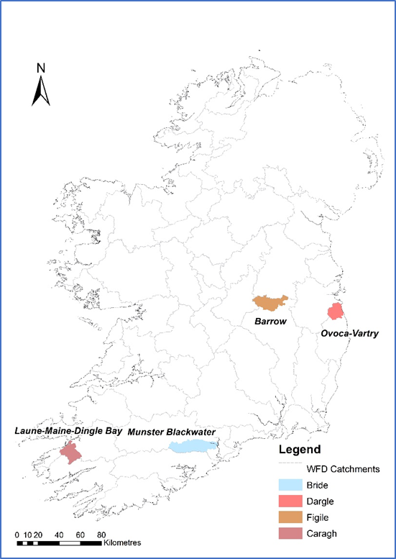
Incase Catchments
Caragh, Co. Kerry: largely a peatland catchment; nature conservation area; rural farming; FPM.
Bride, East Cork: largely agricultural catchment
Figile, East Offaly: considerably impacted by the peat extraction industry, transition towards renewable energy & peatland rehabilitation.
Dargle, Co. Wicklow: a mix of urban areas, agriculture, forestry, moorland / heathland and peatland.

Slide 8
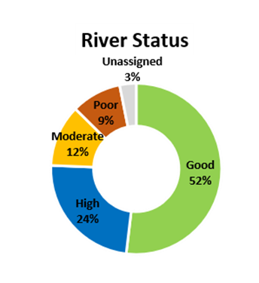
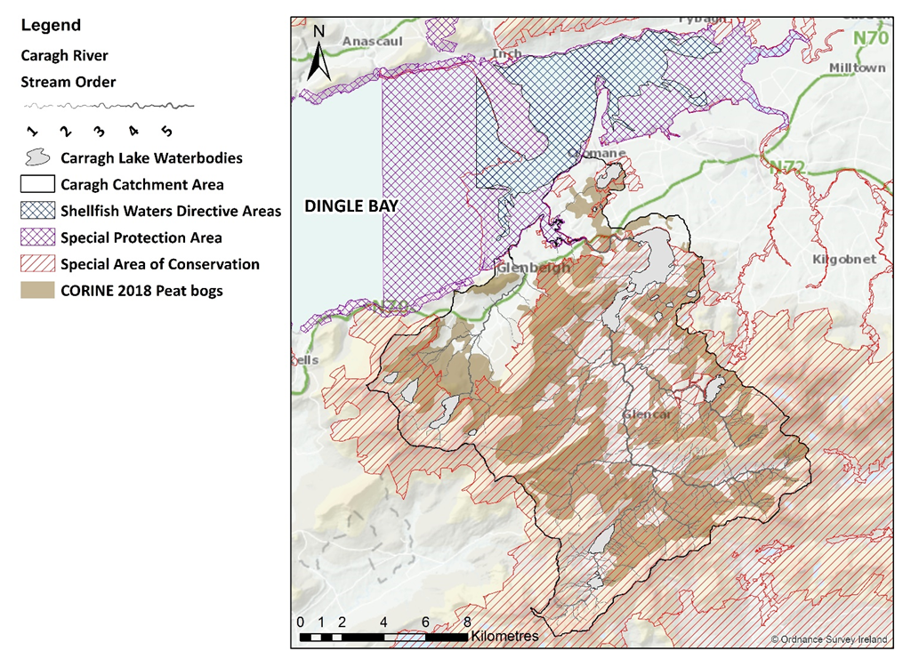
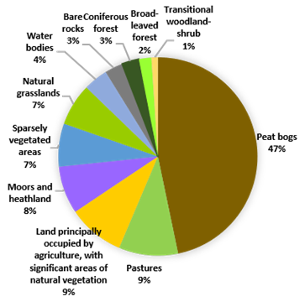
CARAGH, Co. Kerry

Slide 9
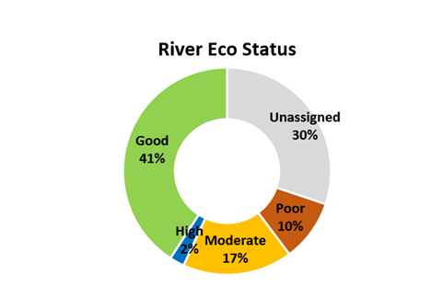
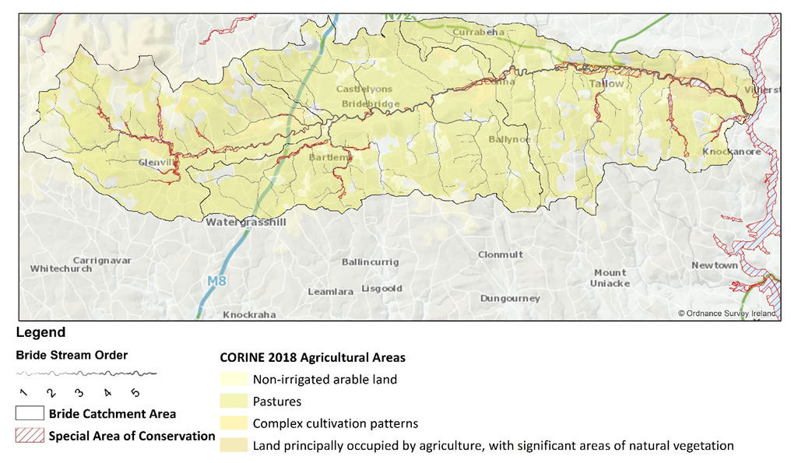
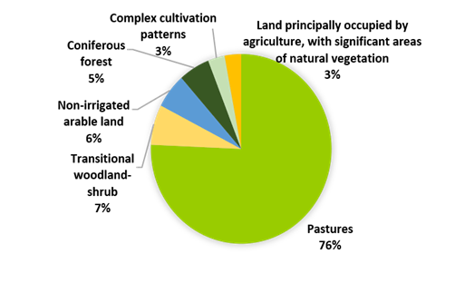
Bride, CO. cork

Slide 10
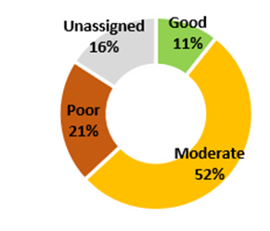
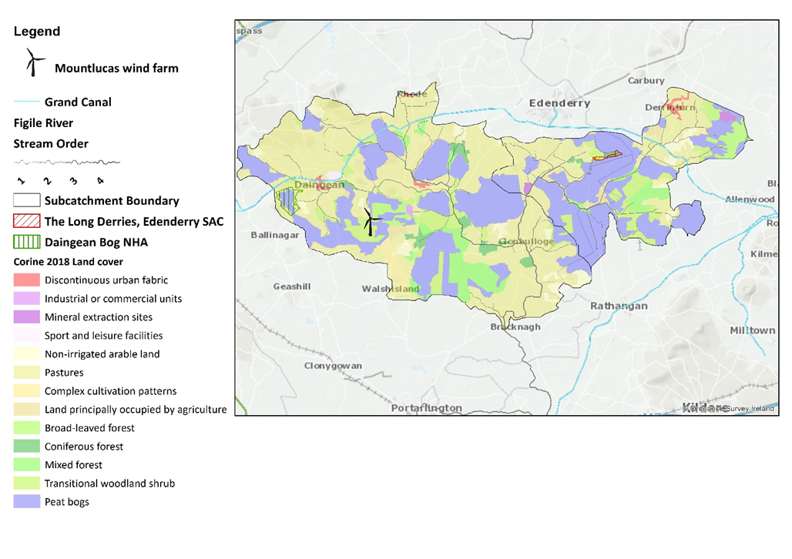
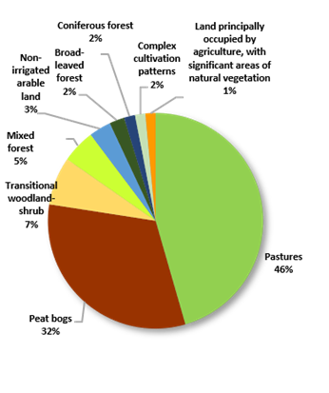
FIGILE, CO. OFFALY

Slide 11
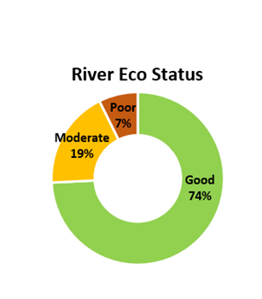
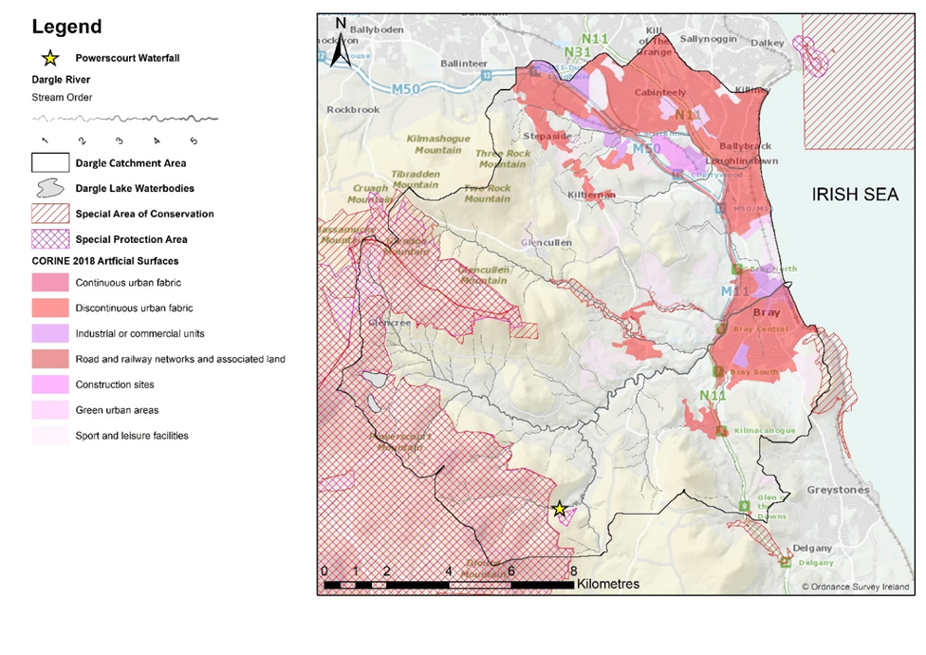
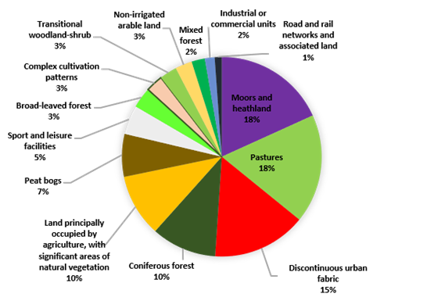
Dargle, CO. Wicklow

Slide 12
INCASE catchment approach
NCA Data requirements CEAF
Data sources and providers; synergies with other projects
INCASE catchments
BNM example
Feasibility assessment; rationale for national profiling

Slide 13
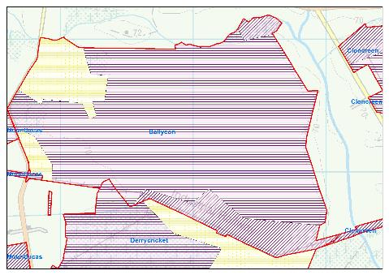
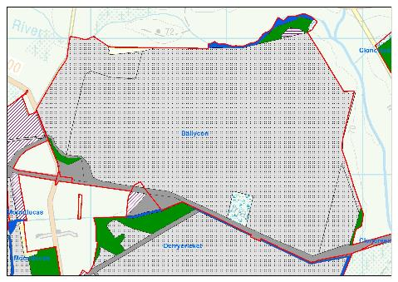
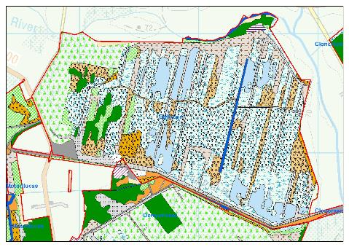
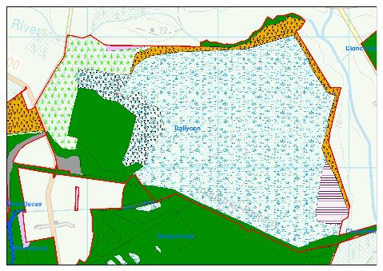
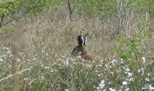
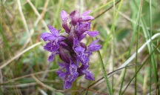
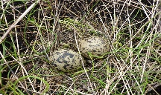
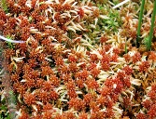
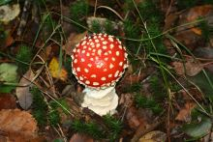
Asset extent
Asset register = asset classification through time
1900: PB1 Raised Bog
1980: PB4I
Industrial
2019: PF1/2; WN7
Pioneer fen/Woodland
2050: PF/WN
Fen/woodland mosaic

Slide 14
Asset extent
changes over time
Ecosystem assets, selected bogs, 2019

Slide 15
Condition
changes over time

Slide 16
INCASE catchment approach
NCA Data requirements CEAF
Data sources and providers
Synergies with other projects
Outline four catchments
BNM example
Feasibility assessment; rationale for national profiling

Slide 17
Incase aims
Build on and bring value to work completed to date (bringing data-sets together from wide-ranging agencies and research projects);
Collaborate with and strengthen synergies with existing projects, while working to
Build a shared platform of information whereby a standardised and coherent information set on natural capital (extent, condition assessment, services and benefits) can be aligned with national income accounts, and
Inform future standardised approaches to data collection, data sharing and effective data use and reporting.

Slide 18
INCASE Feasibility – keep going!
Experienced and multi-disciplinary Project Team and Steering Committee;
A strong motivation based on a number of policy drivers at international and national levels;
The range, standard and quality of data available to construct the accounts at catchment and national level;
The technical expertise in different agencies supporting the project in relation to technical and policy aspects;
The support of a range of stakeholders locally, nationally and internationally.

Slide 19
INCASE – DEVELOP NATIONAL CONTEXT
INCASE catchment: insights/tools that can be used at a national level which are presently unknown;
National profiling would use the same data collated for the INCASE catchment level work
High-level approach creates context for INCASE work, setting up the approach to be used nationally either at catchment level by EPA or developing the accounts at electoral district / county level by the CSO and/or other relevant agencies;
A standardised system of NCA (based on SEEA) established for Ireland up and running in 2020, a common platform for future iterations.

Slide 20
Workshop agenda
10.00-10.30 Coffee
10.30-10.45 Welcome, INCASE overview Jane
10.45-11.15 NCA/EA: what is it, jargon busting; how/who uses it? Carl
11.15-11.25 Q/A
11.25-11.50 INCASE feasibility and catchments, Catherine
12.00-1.00 Lunch!
1.00-1.15 Potential applications? Carl, Catherine
1.15-2.15pm Break-out discussions
2.15pm Feedback; overview discussions
3.00 Close

Slide 21
INCASE APPLICATIONS
Integrating data sets and expertise to create a platform…
To enable efficient and effective delivery of environmental targets locally and nationally, as well as contributing to better reporting measures on sustainable development.
Collating data in standardised format enables better informed decision making around land use and potential trade-offs (co-benefits, disservices)

Slide 22
INCASE APPLICATIONS
Integrated catchment management: main focus of the INCASE project. Water quality relies on integrated and informed decisions around land use (forestry, agricultural, mining, industry, infrastructure etc.) and a full set of NC accounts will enable integrated decisions around activities in a catchment.
Planning urban and rural development: population growth one of main challenges in Ireland. Developing serviced urban settlement while mitigating rural decline and balancing climate action targets on planting etc. will benefit from NCA. Irish initiatives such as the Environmental Sensitivity Mapping tool could be linked with NCA to enable better information for planning.
Marine: following from the WFD and ICM, quality of the marine environment is strongly linked with activities on land (and MSFD and CFP). BIM is exploring how to apply NCA to the seafood industry and the outputs will feed directly into the INCASE catchments that have immediate contact with fisheries. MI?
CAP Reform: Developing Payment for Ecosystem Services schemes for landowners can be facilitated by using the information provided by NCA, targeting work to either maintain and/or restore natural capital stocks and flows. This would build on a number of ongoing EIP projects co-ordinated by DAFM and some of the reforms proposed under the EU CAP.

Slide 23
INCASE APPLICATIONS
Forestry: the Irish Government has set ambitious targets around planting trees as part of its Climate Action Plan. Managing the planting to ensure the stands are on the right soils and appropriate networks will be critical for those targets to be realised.
Peatland management: peatlands cover up to 20% Irish landscape and deliver range of services at catchment level (water filtration; regulation of water flow; biodiversity) and globally (carbon). Co-ordinating peatland rewetting will have multiple benefits for climate, water, people, and biodiversity.
Biodiversity: mapping natural capital will bring together datasets on natural features (habitats and species), enabling co-ordinated and coherent planning for sustainable biodiversity networks alongside human networks and other land uses. Planning for nature will enable linking wildlife corridors with Green and Blue infrastructure initiatives within LA and Regional planning objectives.
European networks: There are obvious synergies with the EU INCA, EU MAES and EU MAIA projects – working as part of a European network will enable the development of NCA in Ireland to benefit from lessons learned across Europe, as well as work to reform EU Directives and policy instruments relating to land use.
Other potential applications: LULUCF reporting (as in the Netherlands), SDG reporting.

Slide 24
Break-out groups
Four groups (leader + scribe + timekeeper)
Introductions (10mins)
Group discussion: 50 mins
What are the potential applications of NCA?
How / can NCA support your work in s/m/l?
How could this be achieved?
General comments / observations

