Slide 1

Accounting for Natural capital
Presentation to INCASE Workshop on Natural Capital Accounting
Carl Obst, Director IDEEA Group
Dublin (via Melbourne), 22 January, 2020

Slide 2

A systems approach to sustainability

Slide 3
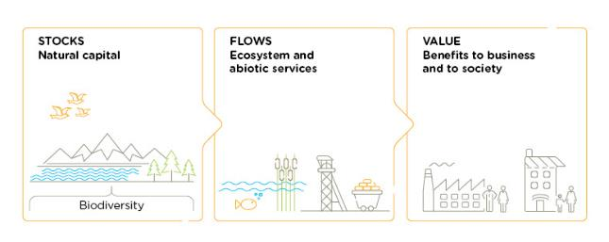
Defining natural capital
Natural Capital
is the stock of renewable and non-renewable natural resources, (e.g. plants, animals, air water, soils, minerals) that combine to yield a
flow of benefits to people
Source: Natural Capital Protocol, 2016

Slide 4
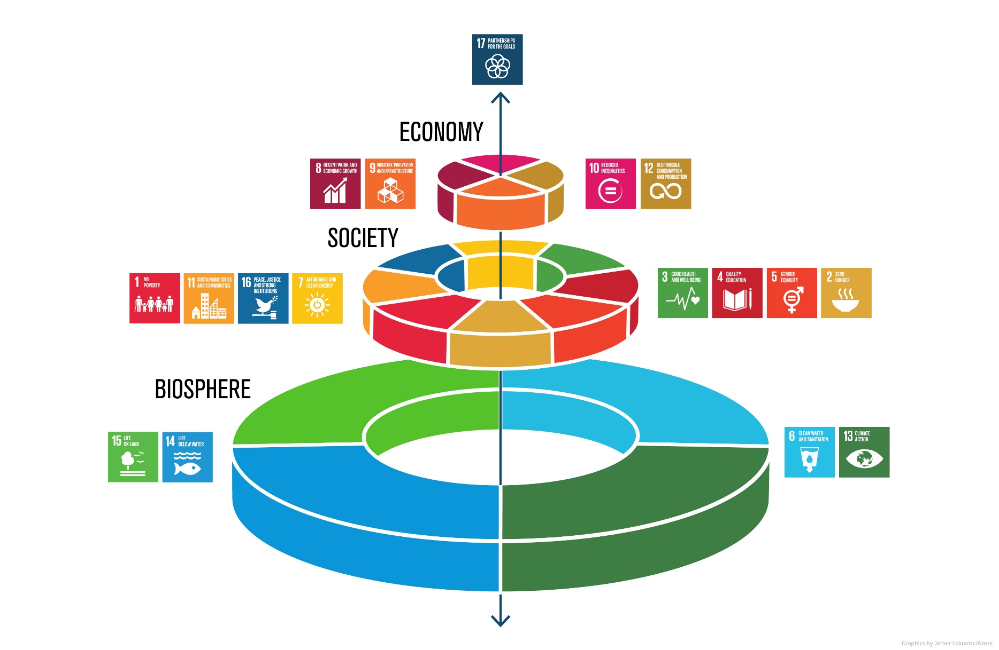
Natural capital and sustainable development

Slide 5
Economic system
Fishing workers
Economic supply chain
Harvested fish
Fishing business
Processing
Fishing vessel

Slide 6
Integrated system – Economic and natural capital
Economic supply chain
Harvested fish
Fishing operator
Processing
Ecosystem services : Fish biomass, Carbon sequestration, Water filtration, Recreation
Natural capital
Fish stock
Sea grass nurseries
Estuaries

Slide 7
Integrated system – Multiple capitals
Local communities
Labour force
People
Society
Economic supply chain
Harvested fish
Fishing operator
Processing
Ecosystem services : Fish biomass, Carbon sequestration, Water filtration, Recreation
Natural capital
Fish stock
Sea grass nurseries
Estuaries

Slide 8
Introduction to the System of Environmental-economic accounting (SEEA)

Slide 9
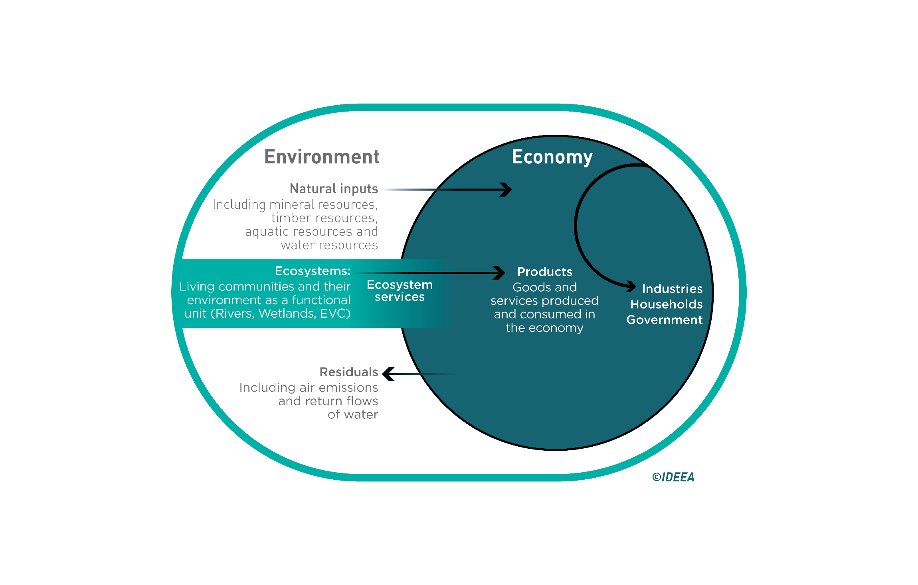
Linking environmental and economic systems

Slide 10
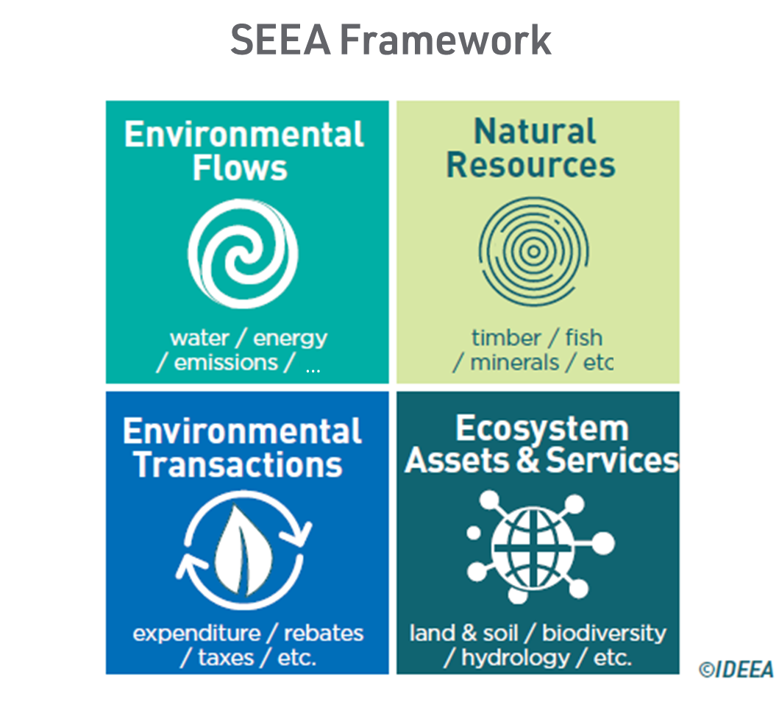
four Types of SEEA accounts

Slide 11
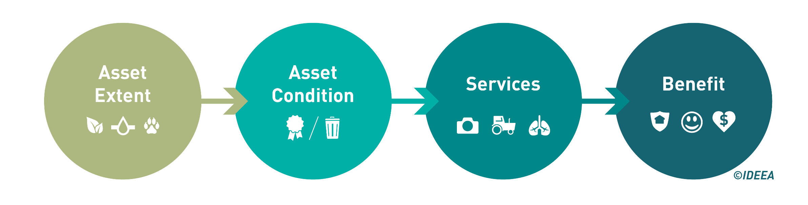
Core ecosystem accounting model
Stocks:
forests, wetlands, rivers, seagrass beds, reefs
Flows:
timber, fish, carbon, water, habitat, recreation, amenity

Slide 12
HIERARCHICAL NESTED ACCOUNTING GRID
National
Region
Catchment
Parcel (farm, property)
Grid cell
(e.g. 20m x 20m or 100m x 100m)
Bio-Regions
Sub-Regional
Biomes
Ecological Veg. Classes
Grid cell – Trees
(e.g. 20m x 20m or 100m x 100m)
Ecosystem Accounting Areas (EAA)
Ecosystem Assets (EA)
Basic Spatial Unit (BSU)

Slide 13
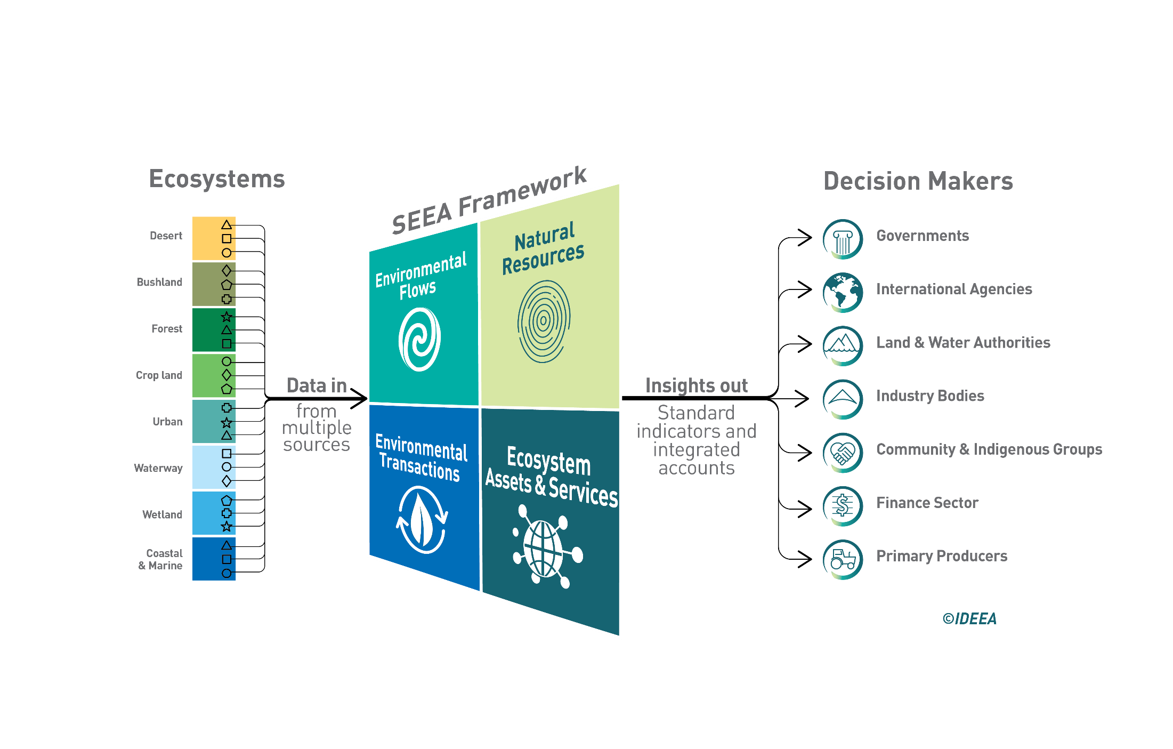
SEEA as an integrating platform

Slide 14
SEEA’s Key features
Accounting features
      Integrate stocks and flows
      Accounting for units / entities and transactions
      Accounting in physical and monetary terms
      Aligned measurement for economy and environment
United Nations international standard
      Common language for exchange of experience and knowledge
      Common basis for collaboration
      Common definitions for data organisation and sharing
      Common concepts for comparison across companies, counties and countries

Slide 15
Accounting for forest ecosystem assets & Services
New Forests, Forico, Tasmania

Slide 16
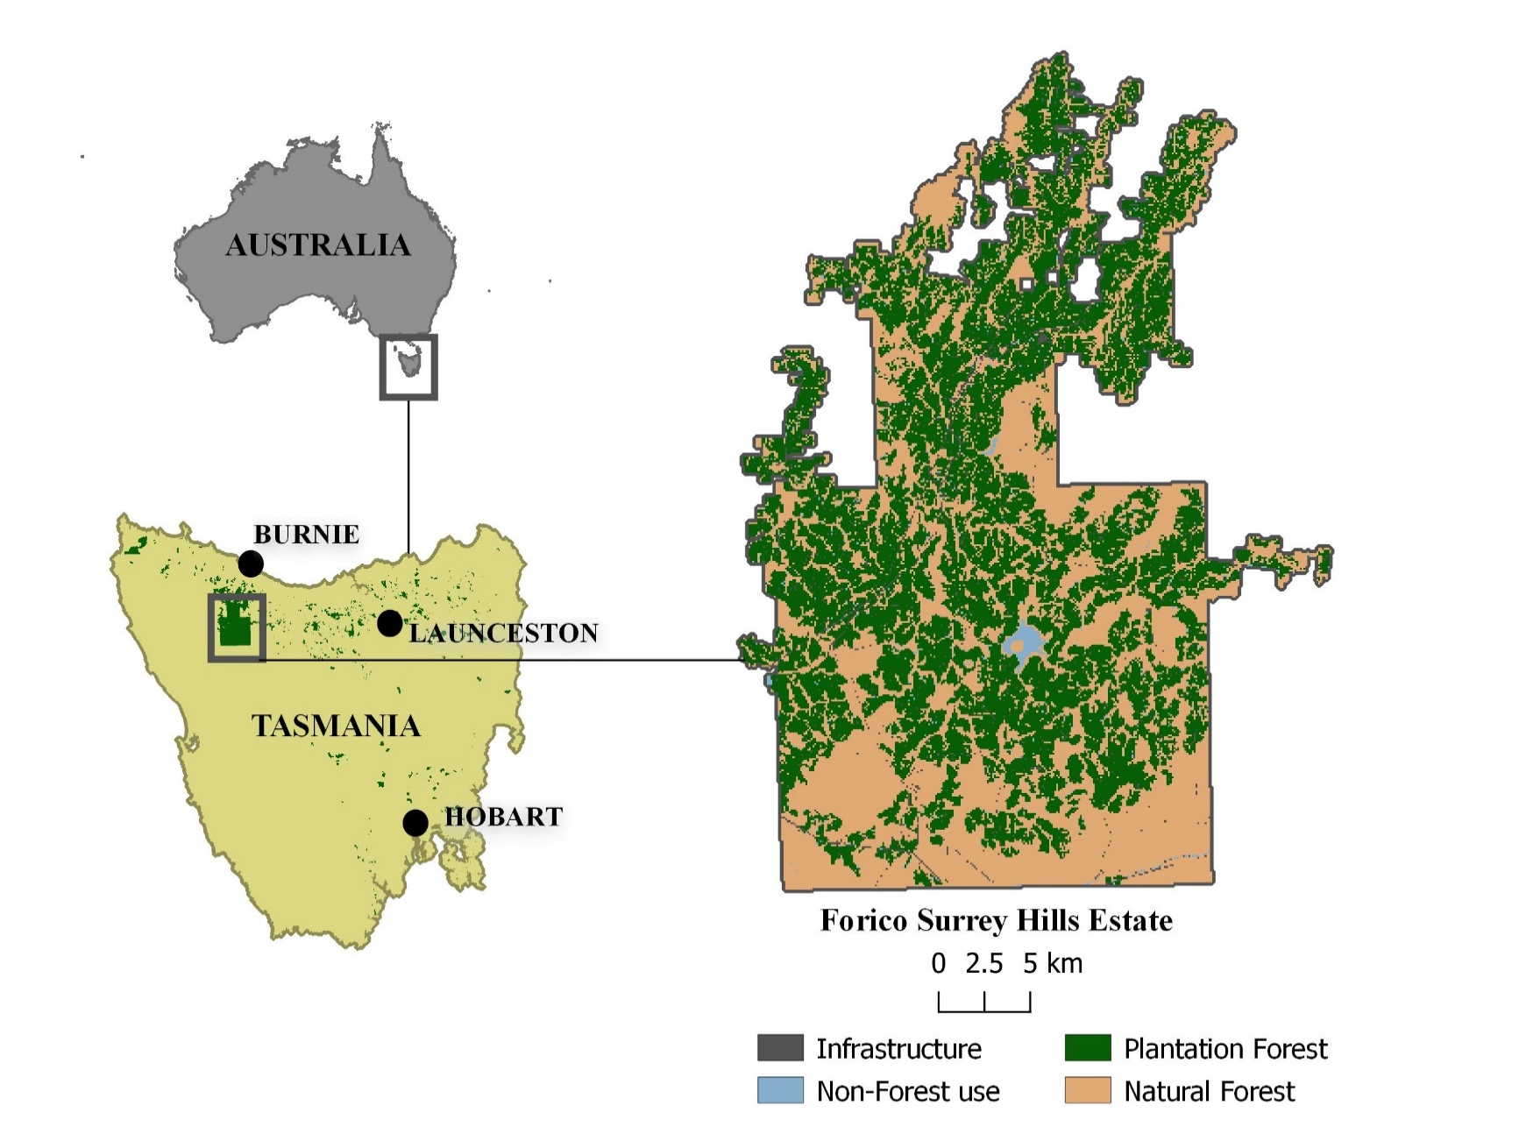
Forico’s forest estate
Forest Management Zones (FMZ)

Slide 17
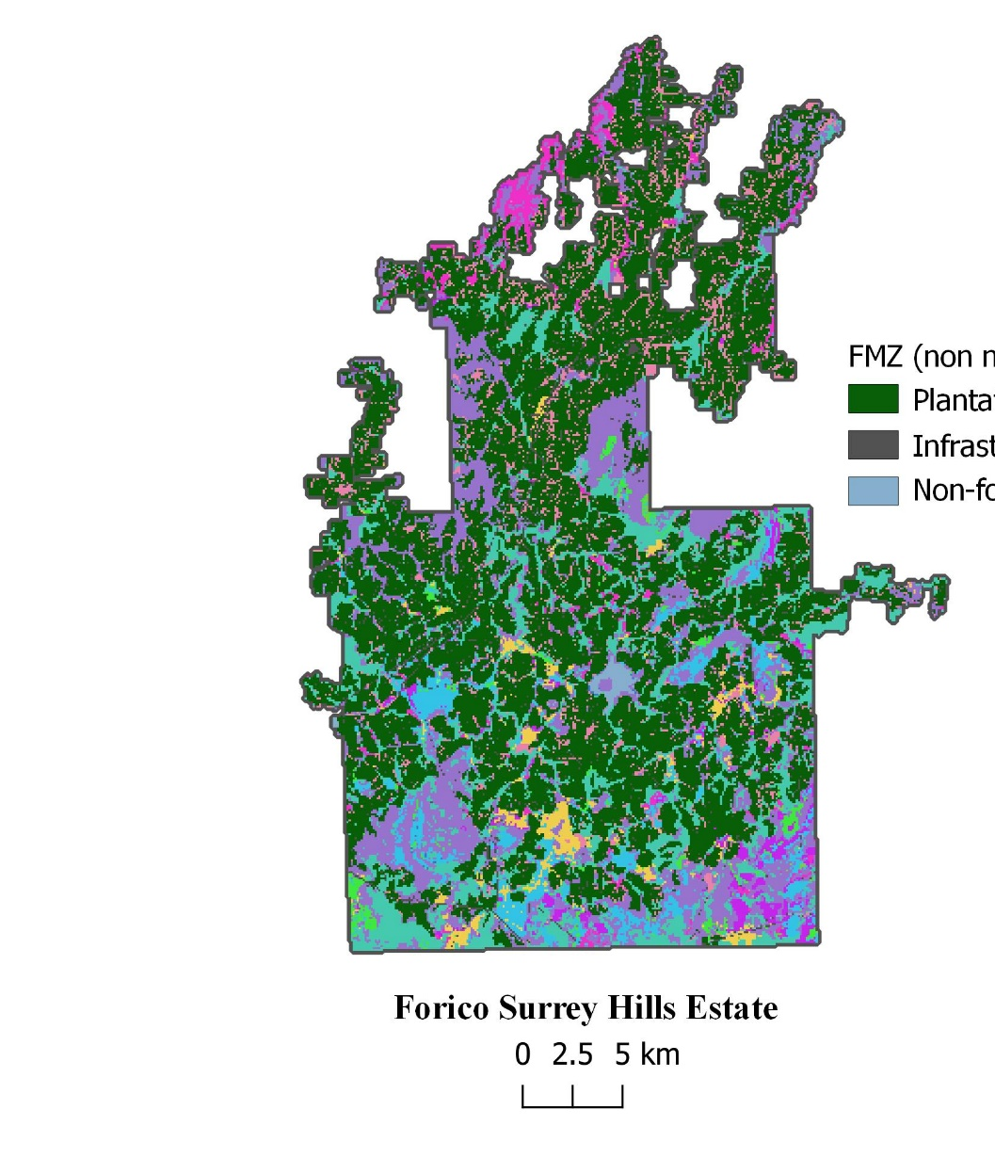
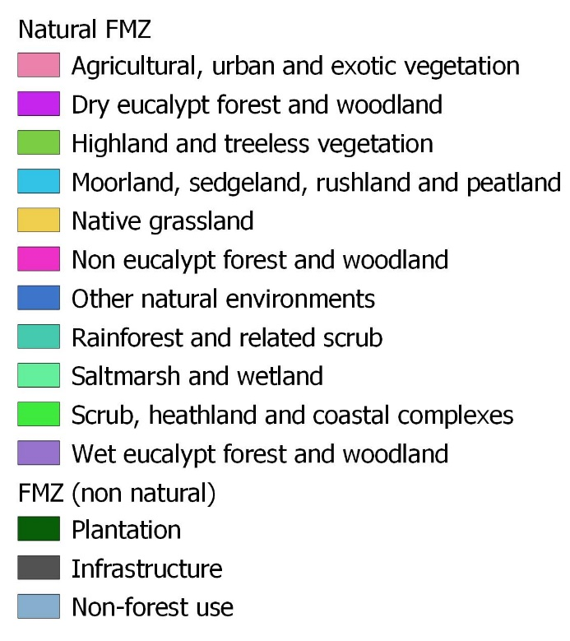
Integrating ecosystem types

Slide 18
Ecosystem condition assessment, 2017

Slide 19
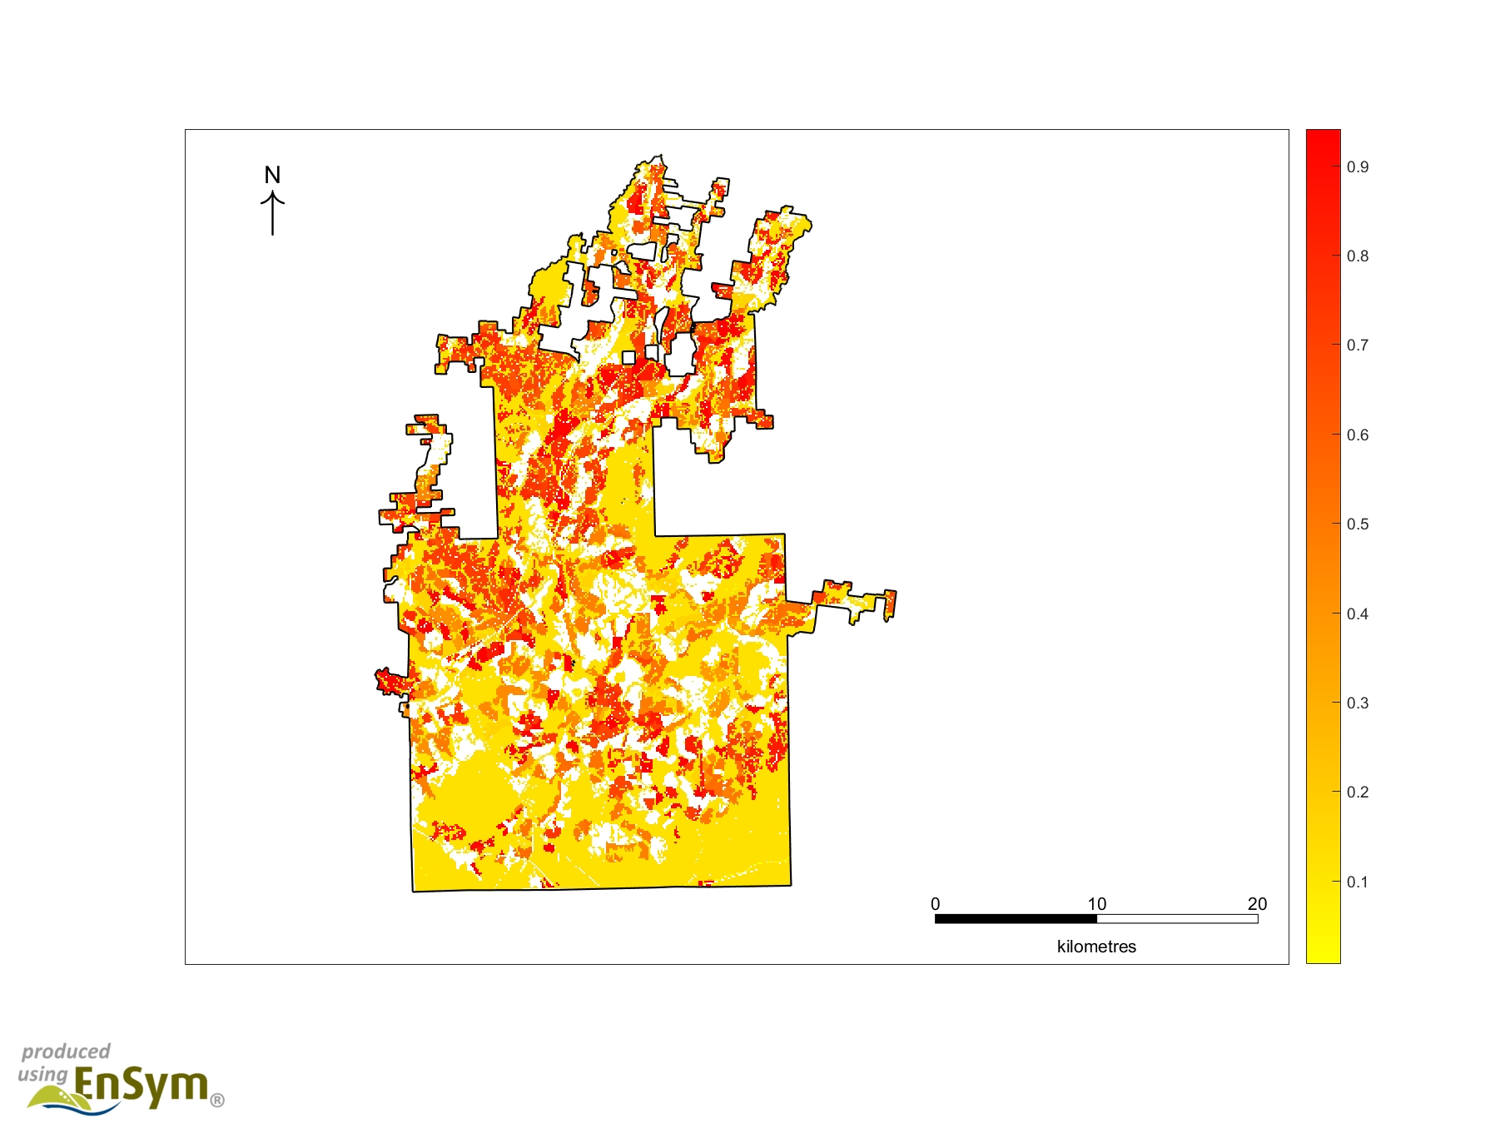
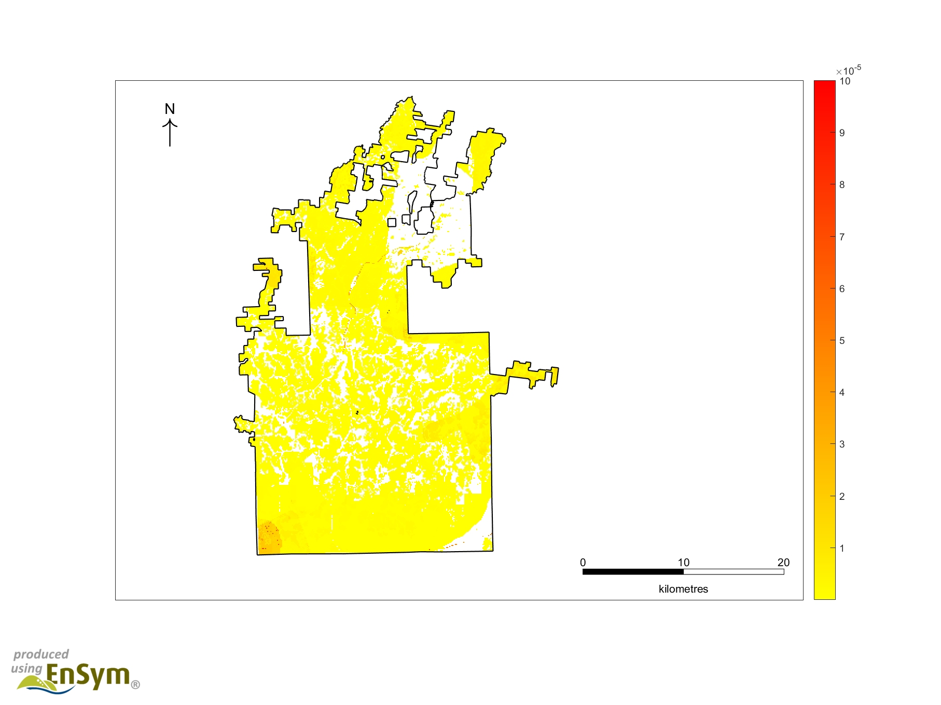
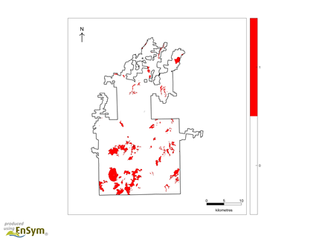
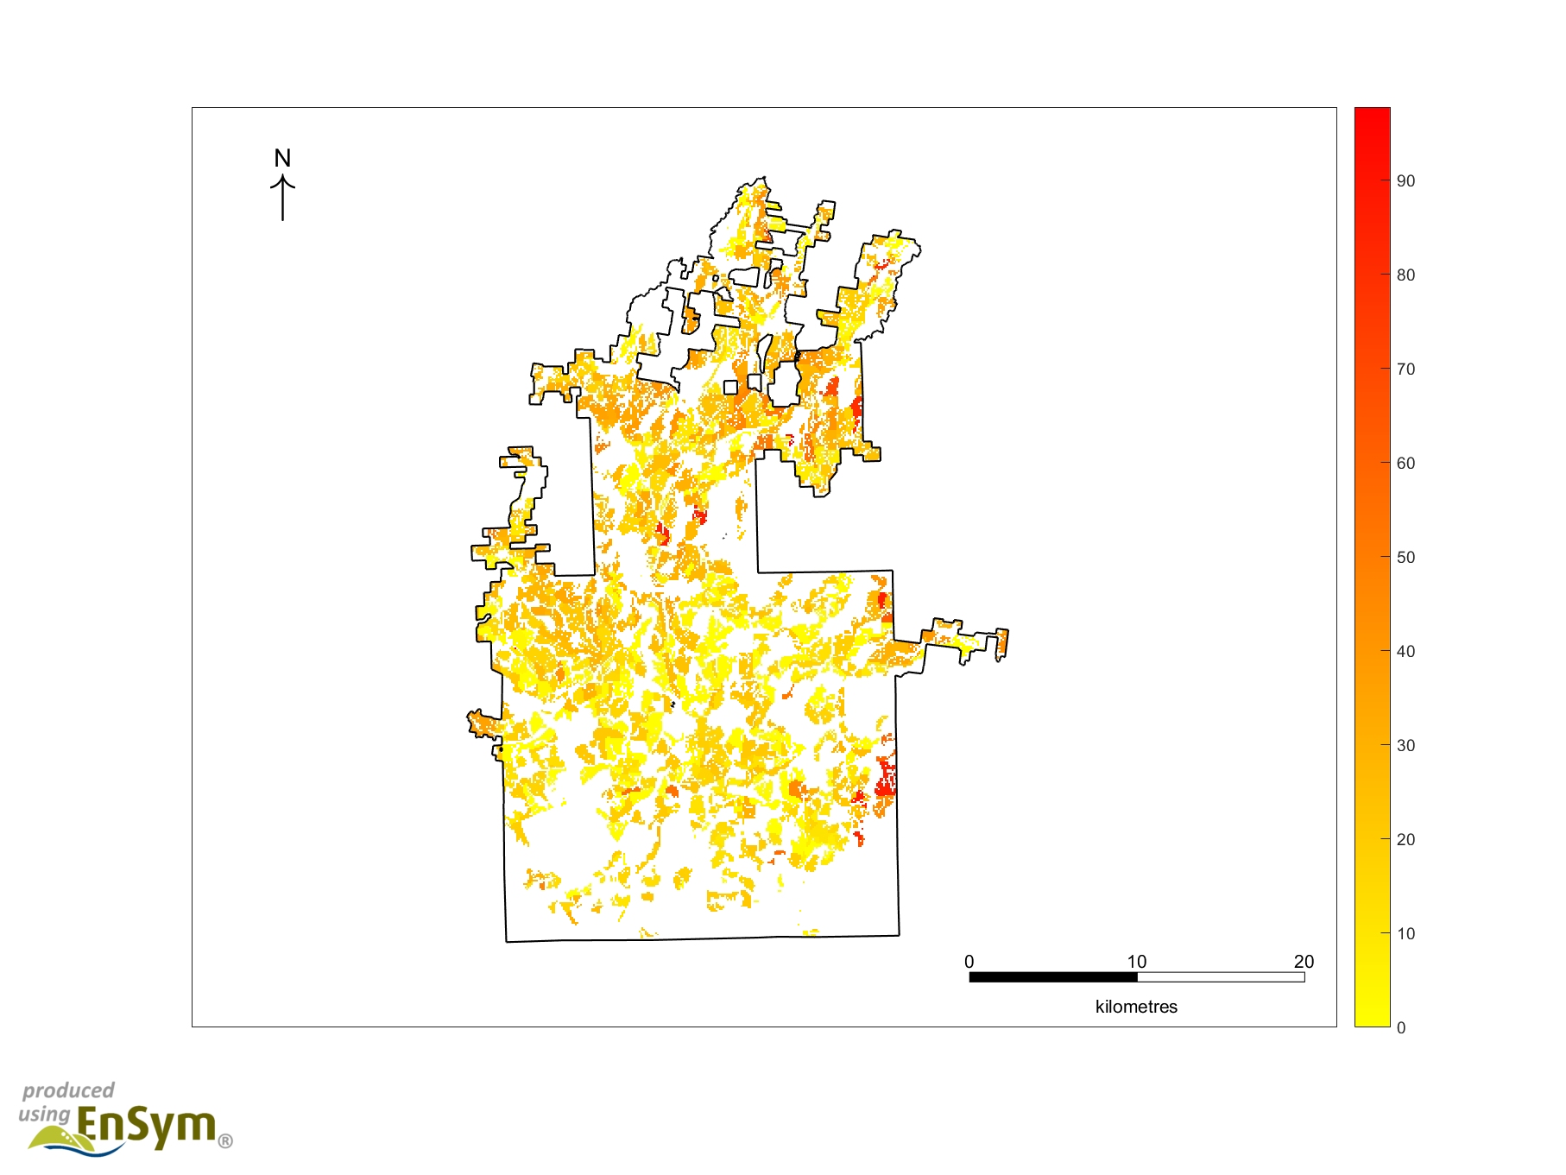
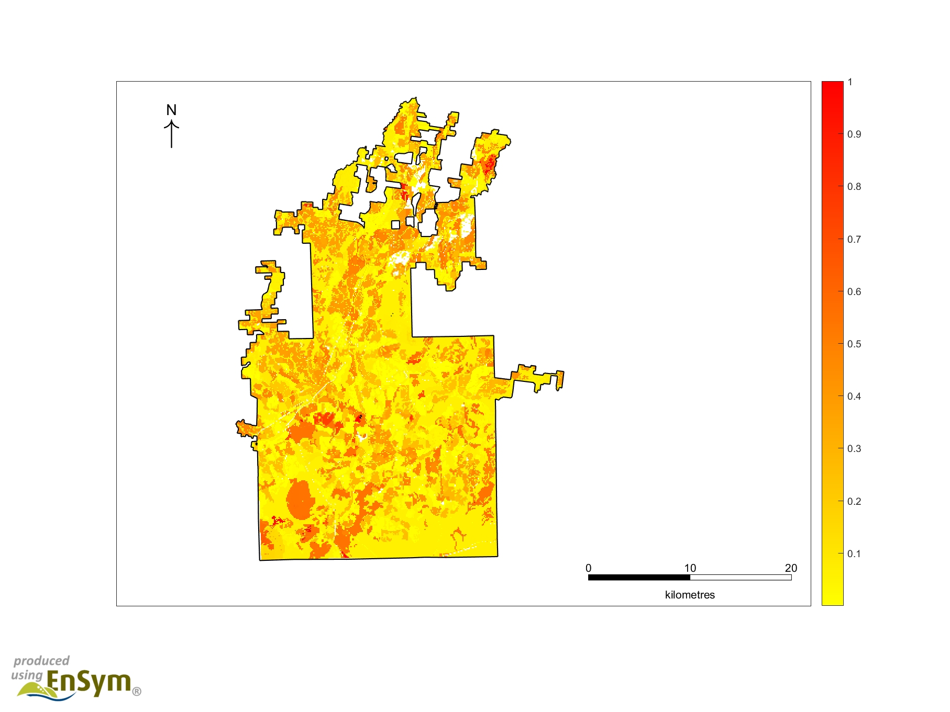
Spatial distribution of ecosystem services
Carbon sequestration
Water provisioning
Habitat provisioning
Timber provisioning
All services (normalised)

Slide 20
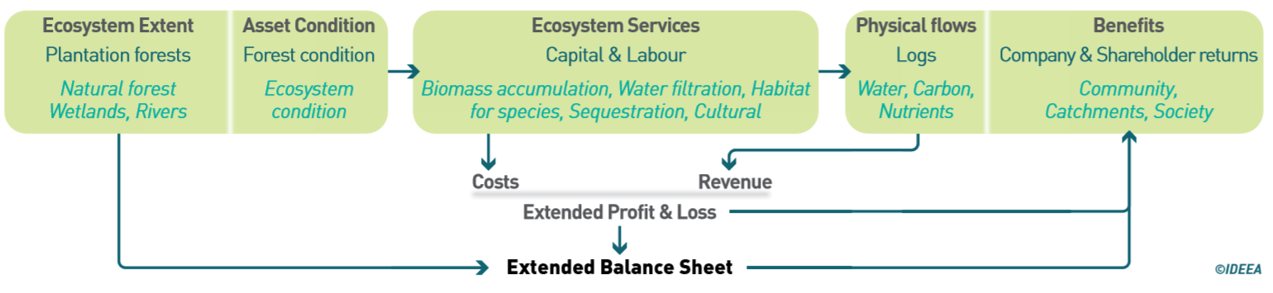
“MAKING EVERY HECTARE COUNT”
Landscape (catchment) management/ optimisatio
Stakeholder engagement – recognising spatial context and multiple values
Non-financial reporting – e.g. corporate sustainability reports; certification (FSC); State of the Forests reporting
Identify new revenue opportunities: Environmental markets (carbon, habitat management); Green finance
Better to do things right the first time, and you'll have a sustainable, profitable investment. David Brand, CEO, New Forests

Slide 21
Implementation of NCA

Slide 22
GLOBAL Progress on implementation of SEEA
Connections to global work
Wealth accounting
WAVES
SDG indicators and linkages
CBD, UNCCD
IPBES
TEEB
IUCN Red List Ecosystems
GEO EO4EA
NatCap Project
Natural Capital Coalition
Source: United Nations Statistical Division, 2019

Slide 23
Examples of natural capital accounting
Forest accounting in Tasmania and Andalucia
Accounting for biodiversity in Uganda and Norway
Ocean wealth accounting in Port Philip Bay, Melbourne
National ecosystem accounts in Netherlands and UK
Condition accounts in South Africa
Land and ocean accounts in Canada
Gross Ecosystem Product in China
…

Slide 24
Ireland & natural capital accounting
  Policy linkages and opportunities
    SDGs
    Marine National Planning Framework consultation process
    Carbon mitigation and adaptation planning
    EU policies and reporting: Biodiversity, Agriculture
Ongoing work in Ireland
    INCASE - catchment scale accounts
    CSO - SEEA accounts development and publication
    BIM - potential ecosystem accounting case studies
    Bord na Mona – peat restoration assessments
    Coillte – Corporate Natural Capital Accounting work

Slide 25
natural capital accounting
It’s Happening and it’s happening now – How will you be involved?

Slide 26
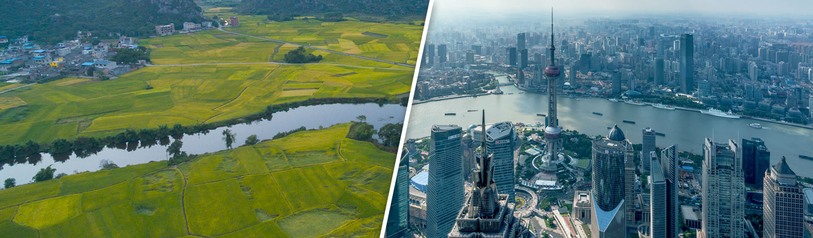
Accounting for ecosystem outcomes
www.ideeagroup.com

