Slide 1
INCASE Irish Natural Capital Accounting for Sustainable Environments
Stakeholder Workshop
January 22nd 2020
https://www.incaseproject.com/
@IncaseProject

Slide 2
Workshop agenda
10.00-10.30 Coffee
10.30-10.45 Welcome, INCASE overview Jane
10.45-11.15 NCA/EA: what is it, jargon busting; how/who uses it? Carl
11.15-11.25 Q/A
11.25-11.50 INCASE feasibility and catchments, Catherine
12.00-1.00 Lunch
1.00-1.15 Potential applications? Catherine
1.15-2.15pm Break-out discussions
2.15pm Feedback; overview discussions, Catherine / groups
3.00 Close, Jane

Slide 3
INCASE overview
WP1: Overview of NCA approaches; Data sources; Literature review and Feasibility Report (completed Feb. 2020)
WP2: Catchment selection (Dargle, Carragh, Figile, Bride); developing NC accounts (asset extent, condition, services and benefits for each catchment) (2020-2022)
WP3: Economic Impact Analysis (land use changes / sectoral changes and I/O models) (2020-2022)
WP4: Management & Communications
Timeframe: March 2019 to March 2023
https://www.incaseproject.com/project-resources

Slide 4
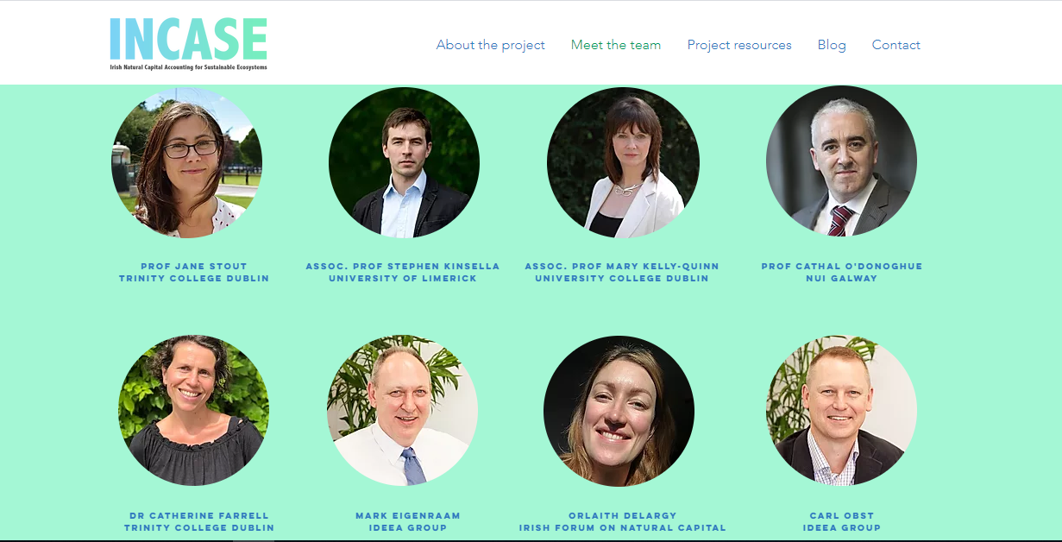

Slide 5
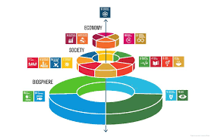
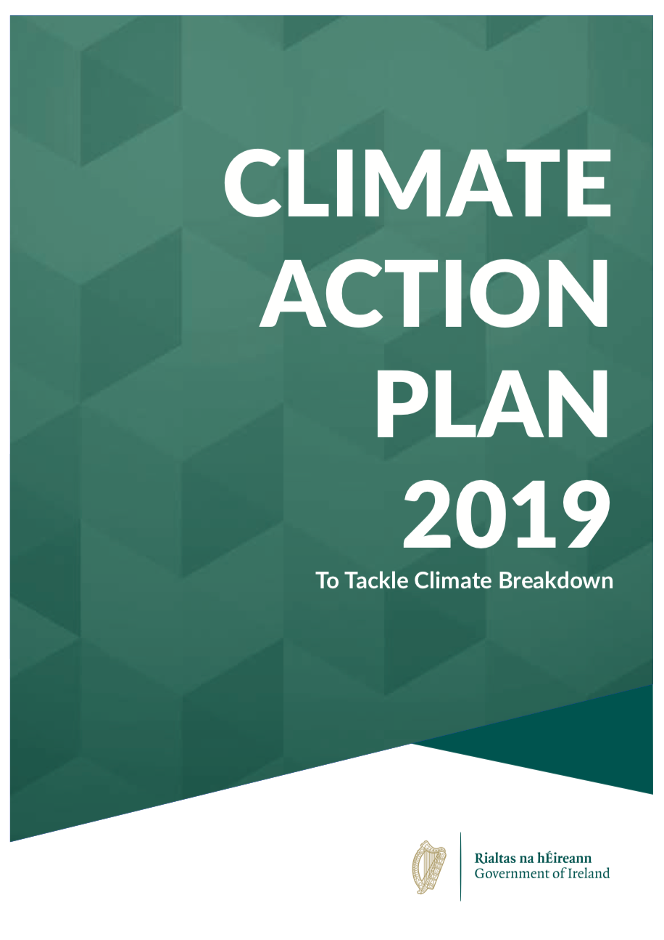
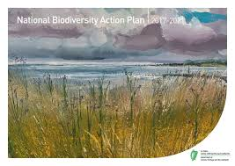
Drivers
All capitals rely on Natural capital
Policy
CBD, UN SDGs, EU Green Deal
Ireland
Building on a range of other projects
CSO Environment a/cs; NPWS MAES etc.
“all EU policies should contribute to preserving and restoring Europe’s natural capital”

Slide 6
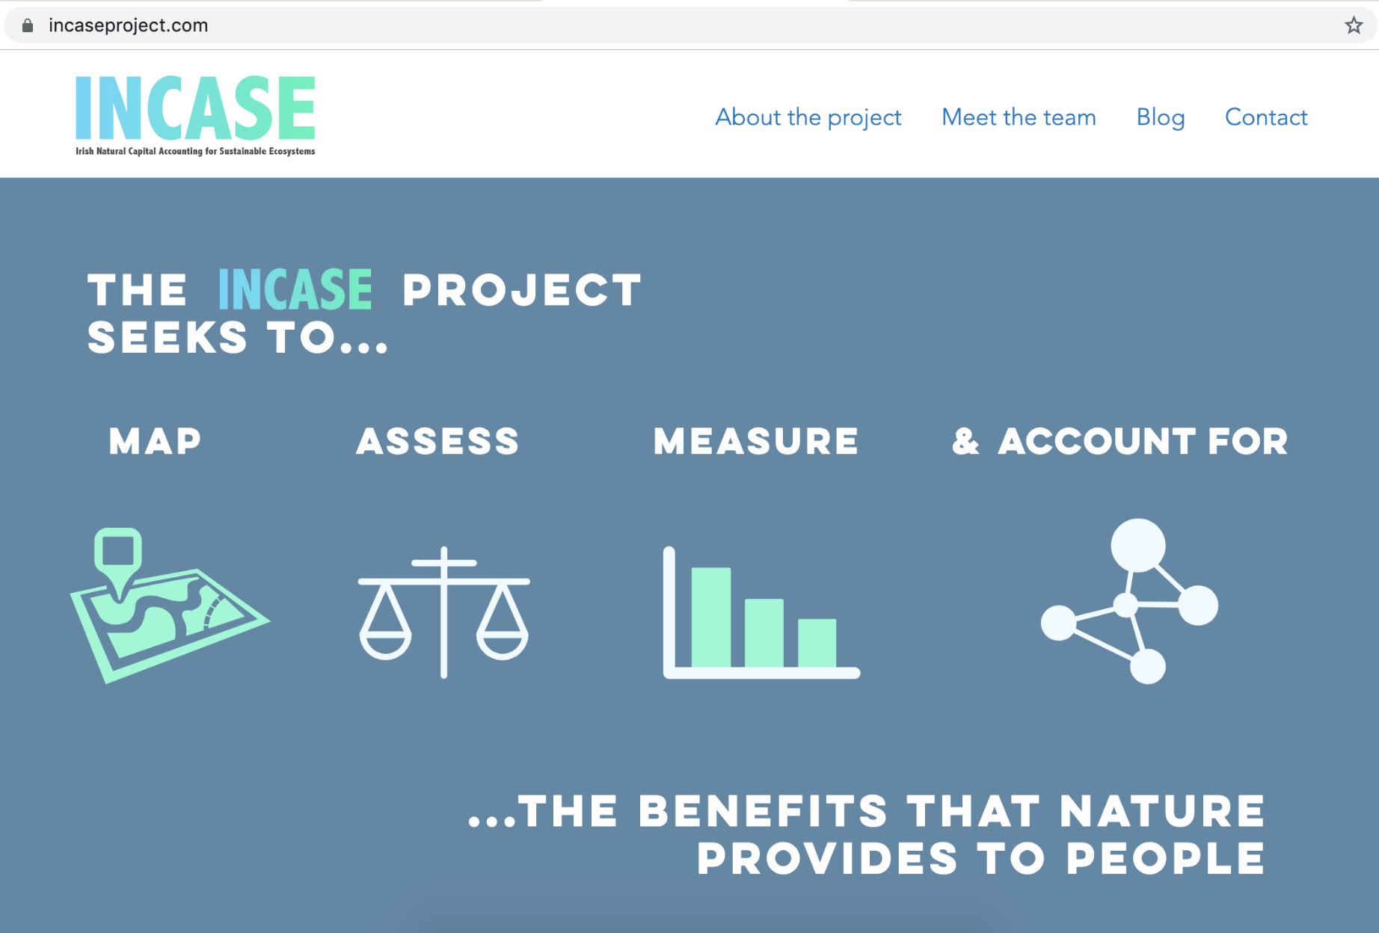
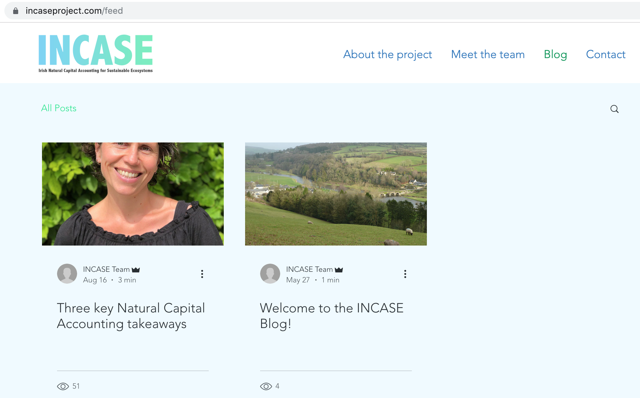
www.incaseproject.com

Slide 7
Next steps
Mar’19-Feb ‘20: Literature review; data assessment; catchment selection; feasibility report)
January 2020: Collate feedback stakeholder workshop
February 2020: Finalise feasibility report to EPA
March 2020: Data share agreements; data gathering
August 2020: Discussion paper on asset condition indicators / working through the detail!
March 2022: Overview of core accounts for each catchment (extent, condition, services, benefits); Economic impact assessments
March 2023: Project ends

Slide 8
Thank you!
https://www.incaseproject.com/
@IncaseProject

